Slide 1

IDEA/APPROACH DETAIL
Category (Software/Hardware): Software Ministry / Organization Name: Ministry of Micro, Small & Medium Enterprises .
Problem Statement Name: Developing Virtual Reality based solutions
Team Name : VROOM
Team Leader Name :Surya Narayanan CS College Code : 1-3512999651

Slide 2
IDEA PROPOSED:
The main aim of the project is to provide a real time environment on to a online meet.
It will be a next stage of education.
Model
Cloud
Environment
Experience
Simulation
Host’s view
The class model will be trained in unity or any other 3d engine.
A default 2d view will be provided, as once the students joins the meet, will be allotted a seat.
3d view- Students
2d view- Teachers
Once the students join the meet, they will be allotted a seat in the class. The 3d view of the classroom will be seen by the students.
The students in the class can able to simulate their character by moving through the keys. If a student wants to leave the class, they can go out of the classroom. If the student wants to move to 1st bench, they can go there.
The developed model will be uploaded to cloud.
The model should trained only once for the virtual environment.
Through the 3d view, the students who are in the meet can experience the real time environment of the class. Making it the next stage of innovation.
A default 2d view of the class will be given to the host where each student is allotted a seat. Host can see the movement of the student. They will get a notification if they leave the class.
HARDWARE REQUIREMENTS:
Integrated Webcam
VR Box
SOFTWARE REQUIREMENTS:
Unity/Unreal engine
Blender
Open CV
AWS
STACK TECHNOLOGIES:

Slide 3

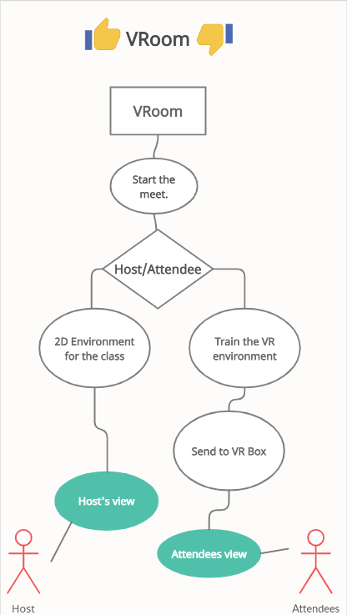
HIGHLIGHTS:
USE CASE:
The students who are present in the class will be displayed to the teachers.
Students once entered the meet will allotted a seat in class.
Students can simulate their character by simply moving through keys.
A real time environment of class will be experienced by the students.
DEPENDENCIES:
A class 3d model has to be trained once before the class or meet starts.
A virtual 2d animated class has to be set up before the class starts for the teachers view.

